Slide 1

Fundamental of JAVA Programming

Slide 2
Content
Objective of JAVA Language
Application of JAVA Programming
JAVA History
Features of JAVA programming
Installation of Eclipse
Installation of JAVA

Slide 3
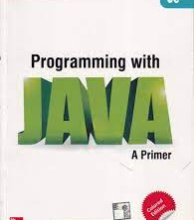
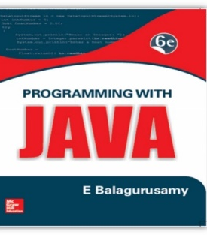
Reference Book
E. Balagurusamy, “Programming With JAVA” , Tata McGraw Hill, 6th Edition

Slide 4

Fundamental of JAVA Programming
UNIT :- I
JAVA FUNDAMENTALS

Slide 5



Unit I: Java Fundamentals
Evolution of Java, Comparison of Java with other programming languages, Java features
Environment, Simple Java Program, Java Tokens, Java Statements, Constants, variables, data types.
Declaration of variables, Giving values to variables, Scope of variables, arrays, Symbolic constants,
Typecasting, Getting values of variables, Standard default values, Operators, Expressions, Type
conversion in expressions, Operator precedence and associativity, Mathematical functions, Control
statements- Decision making & branching, Decision making & looping.

Slide 6
What is JAVA?
General Purpose
Object Oriented Programming
High Level Programming Language

Slide 7
Why JAVA?
Real time application
three billion devices use Java for development
amazing design that incorporates the flexibility to run on any machine

Slide 8

Application of JAVA Programming
Desktop Application
GUI Applications
Web applications
Mobile Applications
Artificial intelligence
Big Data technology
Gaming applications
IDE Tools
Cloud applications
Scientific applications

Slide 9
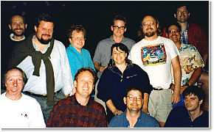
History of JAVA
Developed by Sun Microsystem in 1991
Originally called Oak Language by James Gosling, one of the inventors of the language
Designed for the development of software for consumer electronics devices like TV, VCR
Renamed as JAVA
Its just name, not an acronym
GREEN TEAM

Slide 10
Java Milestones
Year | Development
1990 | Sun decided to developed special software that could be used for electronic devices. A project called Green Project created and head by James Gosling.
1991 | Explored possibility of using C++, with some updates announced a new language named “Oak”
1992 | The team demonstrated the application of their new language to control a list of home appliances using a hand held device with a touch sensitive screen.
1993 | The World Wide Web appeared on the Internet and transformed the text-based interface to a graphical rich environment. The team developed Web applets (tiny programs) that could run on all types of computers connected to the Internet.

Slide 11
Java Milestones
Year | Development
1994 | The team developed a new Web browsed called “Hot Java” to locate and run Applets. HotJava gained instance success.
1995 | Oak was renamed to Java, as it did not survive “legal” registration. Many companies such as Netscape and Microsoft announced their support for Java
1996 | Java established itself as both 1. “the language for Internet programming” 2. a general purpose OOP language.
1997- | A class libraries, Community effort and standardization, Enterprise Java, Clustering, etc..
2010 | Oracle Acquired Sunmicrosystem

Slide 12

What makes JAVA a popular choice?
Compiled and Interpreted Language
Platform Independent and Portable
Object Oriented
Robust and Secure
Distributed
Simple and Easy Language
Multithreading
High Performance
Dynamic and Extensible
Refer:- T1,Chapter2, JAVA Evolution, Topic :- JAVA Feature

Slide 13
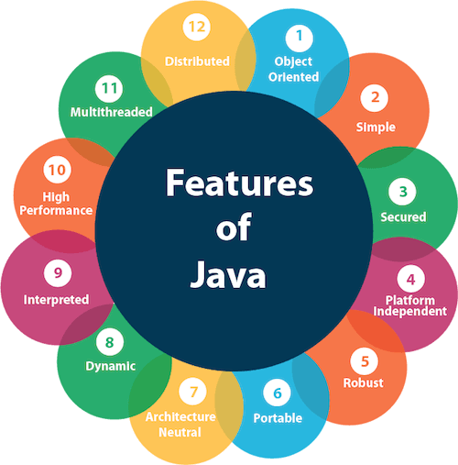

Slide 14

Java Features
Compiled and interpreted
Platform-Independent and Portable
Object-Oriented
Robust and Secure (strict compile time, memory management, eliminates system crash, no memory access, no virus)
Distributed ( ability to share both data & program)
Simple, Small, Familiar (familiar like simplified C++)
Multithreaded and Interactive
High Performance (high speed low overhead)
Dynamic and Extensible (dynamically linking new class lib, methods, objects, supports function of C, C++)
Ease of Development (reusable code by compiler)
Scalability and Performance (reduced startup time, amount of memory)

Slide 15

Java Vs C
JAVA | C
1) Java does not includes sizeof and typedef | 1) C include keywords sizeof and typedef
2) Java does not contain the data type struct and union | 2) C contain the data type struct and union
3) Java does not support pointer type variable | 3) C support pointer type variable
4) Java does not have a preprocessor and therefore we cannot use #define, #include and #ifdef statements | 4) C have a preprocessor and therefore we can use #define, #include and #ifdef statements
5) It does not define type modifiers keywords auto, extern, register, signed, unsigned | 5)It define type modifiers keywords auto, extern, register, signed, unsigned
6) New operators instanceof and >>> | 6) Not available
Refer:- T1,Chapter2, JAVA Evolution, Topic :- How JAVA Differs from C and C++

Slide 16
Java Vs C++
JAVA | C++
1) Java is true Object-oriented language. | 1) C++ is basically C with Object-oriented extension.
2) Java does not support operator overloading. | 2) C++ supports operator overloading.
3 ) Java does not support global variable. Every variable should declare in class. | 3) C++ support global variable.
4) Java does not use pointer. | 4) C++ uses pointer.
5) It does not supports Multiple inheritance of classes (instead of this java has ‘interface’) | 5) C++ support Multiple inheritance of classes
6) There are no header files in Java. | 6) We have to use header file in C++.
7) Java has replaced the destructor function with a finalize() function
Refer:- T1,Chapter2, JAVA Evolution, Topic :- How JAVA Differs from C and C++

Slide 17
Overlap of C, C++, and Java
C++
C
Java
Pune Institute of Computer Technology E&TC Department

Slide 18

How JAVA Works?
.java file
.class file
JAVA Compiler
JAVA Program
(Editor)
JAVA Byte Code
javac
Passed on to JVM
Output
Interpreter
JVM
Refer:- T1,Chapter2, JAVA Evolution,
Topic :-JAVA Development Kit

Slide 19
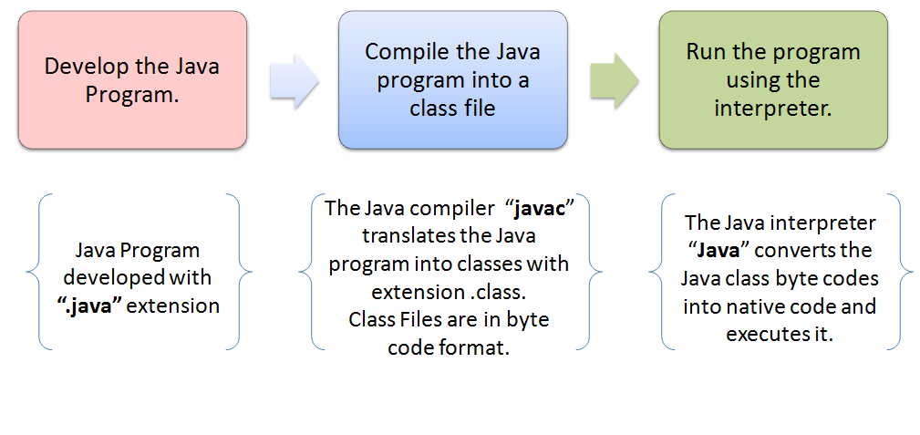
Pune Institute of Computer Technology E&TC Department

Slide 20
JDK, JRE and JVM
JDK (JAVA Development Kit)
It is package used for developing the JAVA application and converting java code to byte code
Conversion is happened using java compiler
Refer:- T1,Chapter2, JAVA Evolution,
Topic :-JAVA Development Kit

Slide 21
JDK, JRE and JVM
JRE (JAVA Runtime Environment)
It’s takes responsibility to run JAVA code with the help of JVM
It’s also provided the JAVA libraries (inbuilt)
Refer:- T1,Chapter2, JAVA Evolution,
Topic :-JAVA Development Kit

Slide 22
JDK, JRE and JVM
JVM (JAVA Virtual Machine)
JVM execute the byte code and produce the output of application
Without JVM we can not run the JAVA program
Refer:- T1,Chapter2, JAVA Evolution,
Topic :-JAVA Development Kit

Slide 23
Behind the scene
.java file
.class file
JAVA Compiler
JAVA Program
(Editor)
JAVA Byte Code
javac
JDK
JRE
Output
JVM
Refer:- T1,Chapter2, JAVA Evolution,
Topic :-JAVA Development Kit

Slide 24
JAVA Framework
JAVA SE: Standard Edition
JAVA EE: Enterprise Edition
JAVA ME: Micro Edition

Slide 25
Java Applications
We can develop two types of Java programs:
Stand-alone applications
Web applications (applets)
Pune Institute of Computer Technology E&TC Department

Slide 26
Applications v/s Applets
Different ways to run a Java executable are
Application- A stand-alone program that can be invoked from command line . A program that has a “main” method
Applet- A program embedded in a web page , to be run when the page is browsed . A program that contains no “main” method
Application –Executed by the Java interpreter.
Applet- Java enabled web browser.
Refer:- T1,Chapter3,
Overview of JAVA Language,
Topic :-Introduction
Pune Institute of Computer Technology E&TC Department

Slide 27
Standalone Application
Stand alone applications are programs written in Java to carry out certain tasks on standalone local computer
In fact, Java can be used to develop programs for all kind of application
Standalone Java program involves two steps
Compiling source code into byte codes using javac compiler
Executing the byte code program using java interpreter
Refer:- T1,Chapter3,
Overview of JAVA Language,
Topic :-Introduction
Pune Institute of Computer Technology E&TC Department

Slide 28
Standalone Application
JAVA COMPILER
JAVA INTERPRETER
OUTPUT
JAVA SOURCE CODE
Java
Application
Refer:- T1,Chapter3,
Overview of JAVA Language,
Topic :-Introduction

Slide 29
Web Applets
Applets are small programs developed for internet applications
Applet located on distant computer (server) can be downloaded via internet and executed on local computer using a Java web browser
Develop applets for doing everything from simple animated graphics to complex games utilities.
Refer:- T1,Chapter3,
Overview of JAVA Language,
Topic :-Introduction
Pune Institute of Computer Technology E&TC Department

Slide 30
JAVA Application
JAVA COMPILER
JAVA ENABLED WEB BROWSER
OUTPUT
JAVA INTERPRETER
OUTPUT
JAVA SOURCE CODE
Java
Applet
Java
Application
Refer:- T1,Chapter3,
Overview of JAVA Language,
Topic :-Introduction

Slide 31
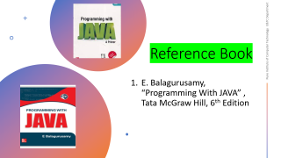
JAVA PROGRAM STRUCTURE
Documentation Section
Package Statement
Import Statement
Interface Statement
Class Definition
Main Method Class { Main Method Definition }
Refer:- T1,Chapter3,
Overview of JAVA Language,
Topic :-JAVA Program Structure
Pune Institute of Computer Technology E&TC Department

Slide 32
JAVA PROGRAM STRUCTURE
Documentation Section
Package Statement
Import Statement
Interface Statement
Class Definition
Main Method Class { Main Method Definition }
Documentation is set of comment line giving the name of program, the author name and other details.
Also declare in comment to which class is used and method in our program
Refer:- T1,Chapter3,
Overview of JAVA Language,
Topic :-JAVA Program Structure

Slide 33
JAVA PROGRAM STRUCTURE
Documentation Section
Package Statement
Import Statement
Interface Statement
Class Definition
Main Method Class { Main Method Definition }
Actually it is first statement in a Java program
Its declare the package name and informs to the compiler that the class defined here belongs to this package
E.g. package student;

Slide 34
JAVA PROGRAM STRUCTURE
Documentation Section
Package Statement
Import Statement
Interface Statement
Class Definition
Main Method Class { Main Method Definition }
Next thing after a package statement may be number of import statements .
Similar to the #include statement in C and C++
Instruct the interpreter to load class contained in the particular package

Slide 35
JAVA PROGRAM STRUCTURE
Documentation Section
Package Statement
Import Statement
Interface Statement
Class Definition
Main Method Class { Main Method Definition }
Interface is like a class but includes a group of method declarations.
It is used when we wish to implement the multiple inheritance.

Slide 36
JAVA PROGRAM STRUCTURE
Documentation Section
Package Statement
Import Statement
Interface Statement
Class Definition
Main Method Class { Main Method Definition }
Classes are primary and essential elements of Java Program.
It is map the real world problems.
No of classes in a program depends on the complexity of the program

Slide 37
JAVA PROGRAM STRUCTURE
Documentation Section
Package Statement
Import Statement
Interface Statement
Class Definition
Main Method Class { Main Method Definition }
Main method class is an essential elements of Java Program.
Its include the main method.
Its perform the main task of the program

Slide 38
JAVA PROGRAM STRUCTURE
Documentation Section
Package Statement
Import Statement
Interface Statement
Class Definition
Main Method Class { Main Method Definition }
OPTIONAL
OPTIONAL
OPTIONAL
OPTIONAL
OPTIONAL
ESSENTIAL

Slide 39
Let us Try Out
Building your first Java Program

Slide 40
How to write down the JAVA code?
Requirements:
1) JAVA (JDK installation)
2) IDE:-
A) Eclipse
B) Netbeans
C) IntelliJ Idea
D) Visual Studio Code (VS Code)

Slide 41
IMPLEMENTING JAVA PROGRAMS
Creating the program
Compiling the program
Running the program
Pune Institute of Computer Technology E&TC Department

Slide 42
Implementing JAVA PROGRAMS: 1 - Creating The Program
Class Simple
{
public static void main (String arg[])
{
System.out.println(“Hello World”);
}
}
Pune Institute of Computer Technology E&TC Department

Slide 43
Implementing JAVA PROGRAMS: 1 - Creating The Program
Save file as class name e.g. Simple.java
Same name as that of class name.
Called as source file
May have multiple classes
One of them must contain the ‘main method’
The file name must be the classname of class containing the ‘main method’
Pune Institute of Computer Technology E&TC Department

Slide 44
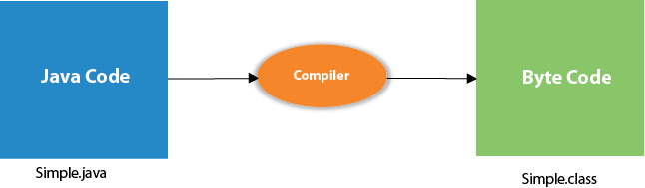
Pune Institute of Computer Technology E&TC Department

Slide 45
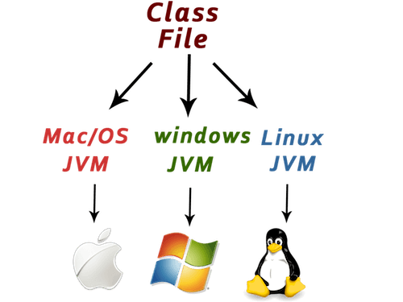
Pune Institute of Computer Technology E&TC Department

Slide 46
Implementing JAVA PROGRAMS: Compiling & Running the Program
javac (java complier)is responsible for compiling the source code.
converts .java to .class (Byte code).
Byte code are machine independent, can be run on any machine.
java (java interpreter)is responsible for running the compiled code.
Reads the byte code fine and translate them into machine code for specific machine.
Interpreter is specially written for each type of machine.
Interpreter looks for the ‘main method’ in the program and begin execution from there.
Pune Institute of Computer Technology E&TC Department

Slide 47
Java Program Editing
Any text editor can be used to write Java Program
e.g. In windows :- Notepad, Edit, Wordpad, MS-Word etc.
In Unix :- vi, emacs, gedit etc.
Save the Program
- Save the program in a file with the name
Simple.java
Pune Institute of Computer Technology E&TC Department

Slide 48
Steps for Implementing Java Code
To write the simple program, you need to open notepad by start menu -> All Programs -> Accessories -> notepad and write a simple program and save as classname .java
To compile and run this program, you need to open the command prompt by start menu -> All Programs -> Accessories -> command prompt.
3) To compile and run the above program, go to your current directory first; my current directory is c:\Java Programming. Write here:
To compile: | javac filename.java
To execute: | java filename
Pune Institute of Computer Technology E&TC Department

Slide 49
Resolving an error "javac is not recognized as an internal or external command"?
To solve this problem by set path
Since DOS doesn't know javac or java, we need to set path.
The path is not required in such a case if you save your program inside the JDK/bin directory. However, it is an excellent approach to set the path.
However, if you have your Java file outside the JDK/bin folder, it is necessary to set the path of JDK.
There are two ways to set the path in Java:
Temporary
Permanent
Pune Institute of Computer Technology E&TC Department

Slide 50
1) How to Set the temporary path of JDK in Windows
To set the temporary path of JDK, you need to follow the some steps:
Open the command prompt
Copy the path of the JDK/bin directory
Write in command prompt: set path=copied_path
Pune Institute of Computer Technology E&TC Department

Slide 51
2) How to Set the permanent path of JDK in Windows
For setting the permanent path of JDK, you need to follow these steps:
Go to MyComputer properties -> advanced tab -> environment variables -> new tab of user variable -> write path in variable name -> write path of bin folder in variable value -> ok -> ok -> ok
Pune Institute of Computer Technology E&TC Department

Slide 52
Hello world
// hello.java: Hello world program
class HelloWorld
{
public static void main(String args[])
{
System.out.println(“Hello World”);
}
}
Pune Institute of Computer Technology E&TC Department

Slide 53
SIMPLE JAVA PROGRAM
1) Class Declaration
public class Sampleone
{
public static void main (String arg [])
{
System.out.println(“Java is Programming Language”);
}
}
2) Main Method
3) Output Line
Pune Institute of Computer Technology E&TC Department

Slide 54
Class Declaration
First line
class sampleone
declare a class, which is object oriented construct
Java is truly object oriented language and therefore everything must be placed inside the class
Sampleone is a java identifier that specifies a name of class
Opening Brackets
Every class definition in Java begin with an opening brackets { and end with closing bracket }, similar to C++ class construct but in C++ class ends with semicolon.
Pune Institute of Computer Technology E&TC Department

Slide 55
Main Line
public static void main (string args[ ])
Defines a method named main.
This is similar to the main() function in C++
Every Java application program must include the main () method
It is starting point for the interpreter to begin the execution of the program
Java application can have many number of classes but only one of them must include a main method to initiate the execution (Note that Java applets will not use the main method at all)
Pune Institute of Computer Technology E&TC Department

Slide 56
Main Line
public:- Keyword public is an access specifier that declares the main method as unprotected and accessible to all other classes.
static :- Next appears the keyword static, which declares this method as one that belongs to the entire class and not a part of any object of the class
Main method always declared as static since the interpreter uses this method before any object are created
void :- type modifier void states that main method does not return any value
All parameters to method are declared inside a pair of parentheses
String arg[] declares a parameter name arg, which contains an array of objects of the class type string.
Pune Institute of Computer Technology E&TC Department

Slide 57
Valid JAVA Main Method Signature
public static void main(String[] args)
public static void main(String []args)
public static void main(String args[])
public static void main(String... args)
static public void main(String[] args)
public static final void main(String[] args)
final public static void main(String[] args)
Pune Institute of Computer Technology E&TC Department

Slide 58
Invalid JAVA Main Method Signature
public void main(String[] args)
static void main(String[] args)
public void static main(String[] args)
abstract public static void main(String[] args)
Pune Institute of Computer Technology E&TC Department

Slide 59
The Output Line
Only executable statement in the program is
System. out. println(“java is programming langauge”);
Similar to the printf() statement of C or cout<< construct of C++
Java is true object oriented language, every method must be part of an object.
println method is a member of the out object, which is static data member of System class.
println always appends a newline character to the end of the string
Pune Institute of Computer Technology E&TC Department

Slide 60
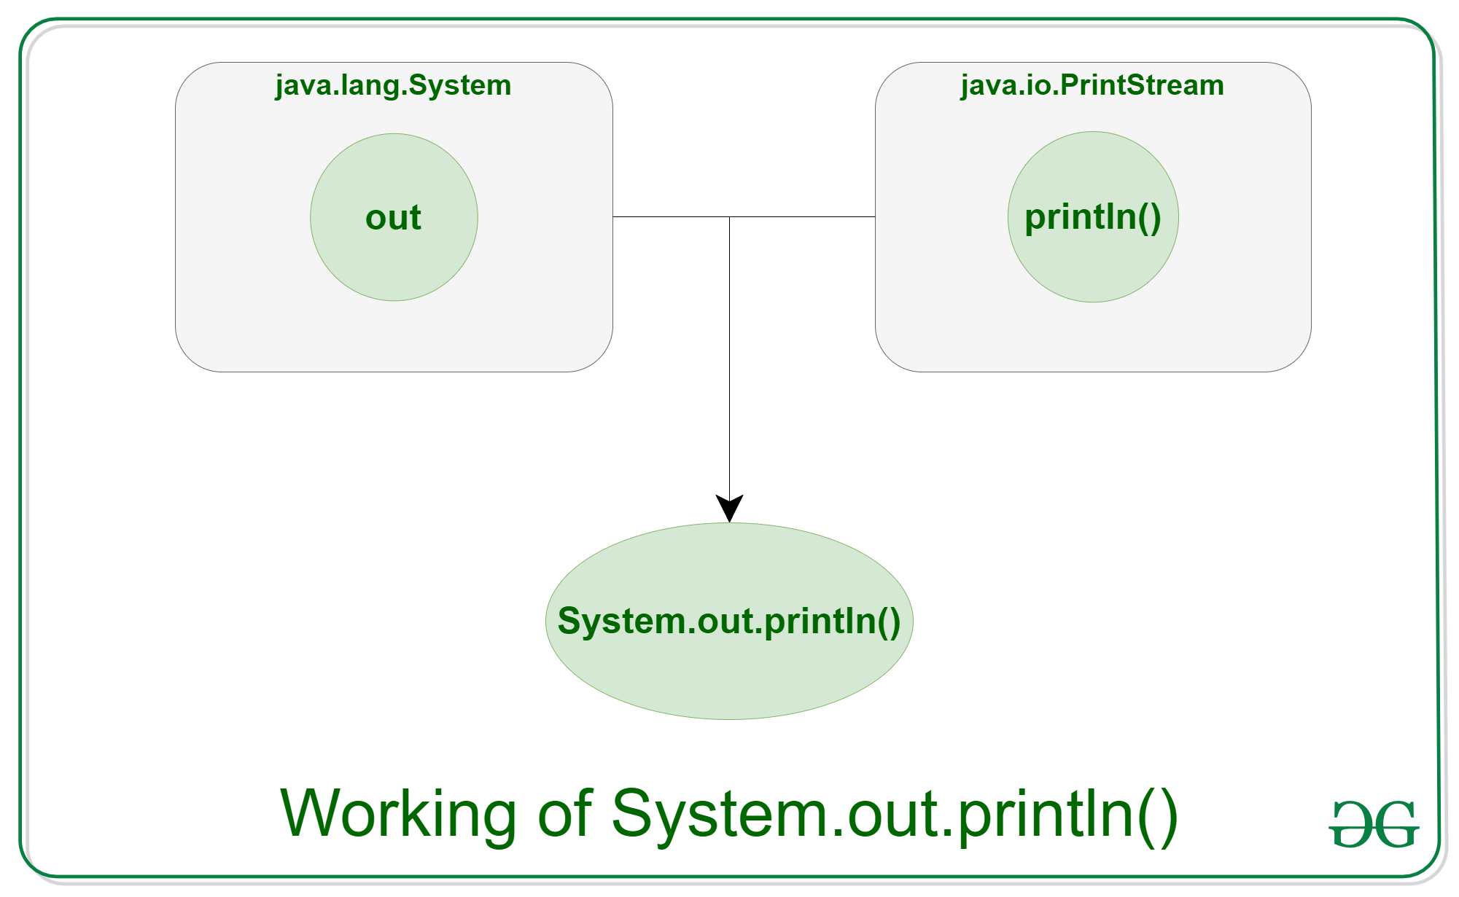
System.out.println()

Slide 61

More of Java
/*
* More Java statements
* This code for find out square root of any number
*/
import java.lang.Math;
Class Squareroot
{
public static void main (string args [])
{
double x=5;
double y;
y=Math.sqrt(x);
System.out.println(“y=”+y);
}
}
Pune Institute of Computer Technology E&TC Department

Slide 62
Application with Two Classes
class Room
{
float length;
float breadth;
void getdata(float a,float b)
{
length=a;
breadth=b;
}
}
class Room
{
public static void main (String args [])
{
float area;
Room room1=new Room();
room1.getdata(14,20);
area=room1.length*room1.breadth;
System.out.println(“area=”+area);
}
}
Pune Institute of Computer Technology E&TC Department

Slide 63
IMPLIMENTING JAVA PROGRAMS
import java .util. Scanner;
class Input
{
public static void main(String args[])
{
Scanner input=new Scanner (System.in);
System.out .println(“Enter the value of number”);
int num= input.nextInt();
System.out.println(“Entered number is ="+num);
}
}
Pune Institute of Computer Technology E&TC Department

Slide 64
IMPLIMENTING JAVA PROGRAMS
package input;
import java.util. Scanner;
class Input
{
public static void main(String args[])
{
Scanner input=new Scanner (System.in);
System.out .println(“Enter the value of number”);
int num= input.nextInt();
System.out.println(“Entered number is ="+num);
}
}
Pune Institute of Computer Technology E&TC Department

Slide 65
JAVA TOKENS
Tokens
Variable Section
Declaration Statement
Declaration Statement
Method 1
Tokens
Expressions & Statement
Methods Section
Tokens
Method 2

Slide 66
JAVA TOKENS
Reserved Keywords
Identifiers
Literals
Operators
Separators
Pune Institute of Computer Technology E&TC Department

Slide 67
JAVA TOKENS- Keywords
Keywords are and essential part of language definition
Its implement the specific features in a program
Java language has reserved 67 words as keywords
Keywords have specific meaning in java we cannot use them as names for variables, classes, methods and so on.
All keywords are written in lower case letters.
Pune Institute of Computer Technology E&TC Department

Slide 68
JAVA TOKENS- Keywords
Abstract | Assert | Boolean | Break
Byte | Case | Catch | Char
Class | Const | Continue | Default
Do | Double | Else | Enum
Extends | Final | Finally | Float
For | Goto | If | Implements
Imports | Instanceof | Int | Interface
Long | Native | New | Package
Private | Protected | Public | Return
Short | Static | Strictfp | Super
Switch | Synchronized | This | Throw
Throws | Transient | Try | Void
Volatile | While
Pune Institute of Computer Technology E&TC Department

Slide 69
JAVA TOKENS- identifiers
Identifiers are programmer designed tokens.
They are used for naming the classes, methods, variables , objects, labels, packages, and interfaces
Java identifiers follow following rules
Alphabet, digits, underscore and dollar sign ($)
Does not start with digit
Case sensitive
Any length
Ex. average, DayTemperature, room_area, TOTAL, etc
Pune Institute of Computer Technology E&TC Department

Slide 70
JAVA TOKENS- Literals, Operators
Literals in Java are a sequence of characters(digits, letters, and other characters) that represents constants values to be stored in variables.
Java specifies five major type of literals
Integer Literals
Floating_point Literals
Character literals
String Literals
Boolean literals
Operators
it’s a symbol that takes one or more arguments and operates on them to produce a result

Slide 71
JAVA TOKENS- Separators
Separators are symbol used to indicate where groups of code are divided and arranged.
they basically define the shape and function of our code
Name | What it is used for
Parentheses ( ) | Used to enclose parameters in method definition and invocation Used for defining priority in expression, containing expressions for flow control, and surrounding cast types
Braces { } | to define a block of code for classes, methods and local scopes Used to contain the values of automatically initialized Array.
Brackets [ ] | Used to declare array types and for dereferencing array values
Semicolon ; | Used to separate statements
Comma , | Used to separate consecutive identifiers in variable declaration
Period . | Used to separate package name from sub-packages and classes; also used to separate a variable or method from a reference variable

Slide 72
JAVA STATEMENTS
A statement is an executable combination of tokens ending with a semicolon (;) mark.
Statements are usually executed in sequence in the order in which they appear
However it is possible to control the flow execution, if necessary, using special statements.
Pune Institute of Computer Technology E&TC Department

Slide 73
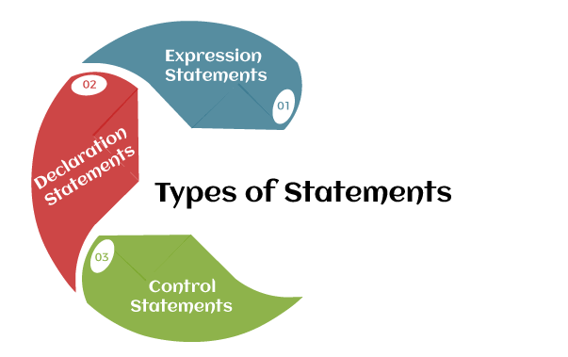
JAVA STATEMENTS

Slide 74
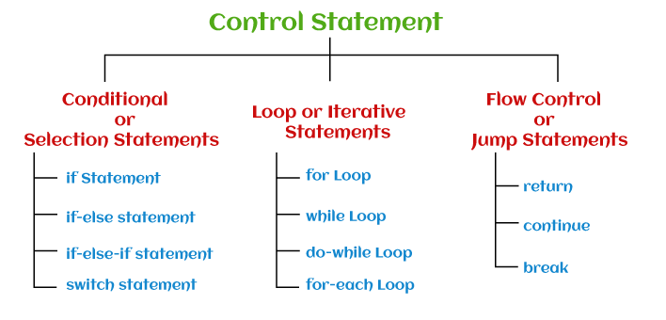
JAVA STATEMENTS

Slide 75
FOR EACH LOOP
It provides an alternative approach to traverse the array or collection in Java. It is mainly used to traverse the array or collection elements.
The advantage of the for-each loop is that it eliminates the possibility of bugs and makes the code more readable.
It is known as the for-each loop because it traverses each element one by one.
The drawback of the enhanced for loop is that it cannot traverse the elements in reverse order
Do not have the option to skip any element because it does not work on an index basis.
Also cannot traverse the odd or even elements only.

Slide 76
FOR EACH LOOP
Syntax:-
for(data_type variable : array /collection)
{
//body of for-each loop
}

Slide 77
FOR EACH LOOP
Example:-
public class ForEachExample1
{
public static void main(String args[])
{
//declaring an array
int arr[]={12,13,14,44};
//traversing the array with for-each loop
for(int i:arr){
System.out.println(i);
}
}
}

Slide 78
IMPLIMENTING JAVA PROGRAMS
/*more java statements…. code for square root*/
import java.lang.Math;
public class squareRoot
{
public static void main(String args[])
{
double x=5; // declaration and initialization
double y;
y=Math.sqrt(x);
System.out.println("Y="+y);
}
}
Pune Institute of Computer Technology E&TC Department

Slide 79
IMPLIMENTING JAVA PROGRAMS
import java .util. Scanner;
public class Input
{
public static void main(String args[])
{
Scanner input=new Scanner (System.in);
System.out .println(“Enter the value of number”);
int num= input.nextInt();
System.out.println(“Entered number is ="+num);
}
}
Pune Institute of Computer Technology E&TC Department

Slide 80
Application with Two Classes
Class Room
{pu
float length;
float breadth;
void getdata(float a,float b)
{
length=a;
breadth=b;
}
}
Class Room
{
public static void main (String args [])
{
float area;
Room room1=new Room();
room1.getdata(14,20);
area=room1.length*room1.breadth;
System.out.println(“area=”+area);
}
}
Pune Institute of Computer Technology E&TC Department

